Slide 1

FOOD
DELIVERY
ANALYSIS
Capstone
Project
Capstone Project – 1 | Food Delivery System Dataset analyzed using Tableau for operational performance insights.
PRESENTED BY
Rucha
2024
TOOL USED
Analysis
Tableau

Slide 2


02
Project Overview
KPIs
OVERVIEW OF PROJECT GOALS, TOOLS, AND KPIS
TABLEAU CSV DATASET
Analyze the operational performance of a food delivery system using Tableau. Dashboard insights cover customer satisfaction, delivery efficiency, order distribution, traffic conditions, vehicle usage, festival impact, and delivery categories.
Total Orders: 45,593 orders analyzed
Customer Rating: 4.634 out of 5
Average Delivery Time: 26.29 minutes
Tool Used: Tableau | Dataset: Food Delivery System

Slide 3
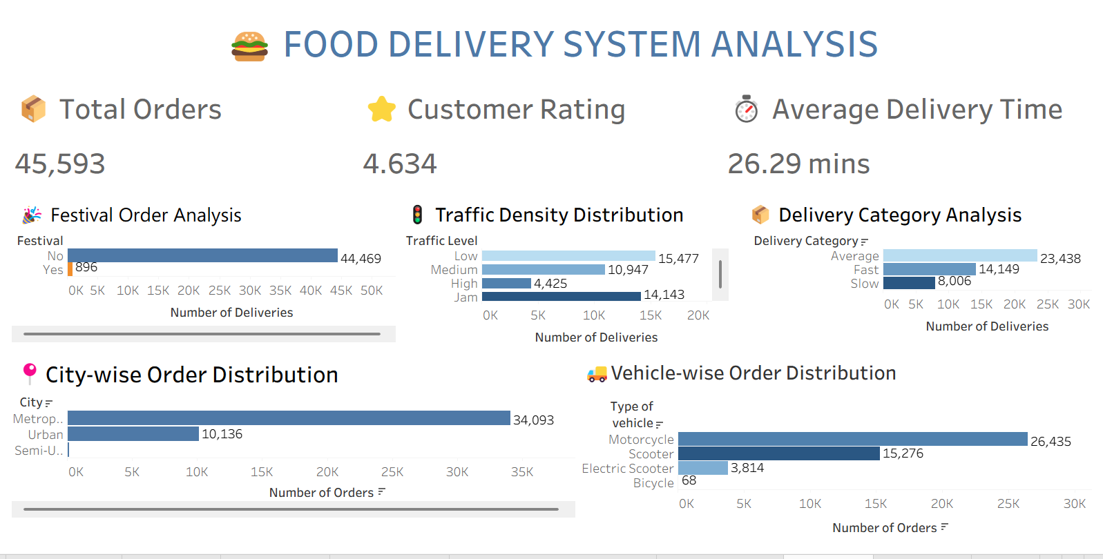
Dashboard Overview
COMPREHENSIVE VIEW OF FOOD DELIVERY OPERATIONS AND BUSINESS PERFORMANCE METRICS
03
The dashboard provides a unified view of all key operational metrics for the food delivery system. It enables monitoring of business performance indicators to identify trends, evaluate delivery efficiency, and understand customer experience. Interactive visualizations support informed decision-making across customer satisfaction, delivery speed, traffic conditions, vehicle usage, festival impact, and regional order distribution — all powered by Tableau.
7
KEY METRICS VISUALIZE

Slide 4
04
KPI Analysis
SUMMARY OF CORE BUSINESS METRICS FROM THE FOOD DELIVERY SYSTEM
01
02
03
04
TOTAL ORDERS
CUSTOMER RATING
AVG DELIVERY TIME
DATA SOURCE
45,593 orders analyzed representing overall business volume
4.634 out of 5 indicating high customer satisfaction
26.29 minutes average with room for further optimization
Food Delivery System Dataset visualized using Tableau

Slide 5
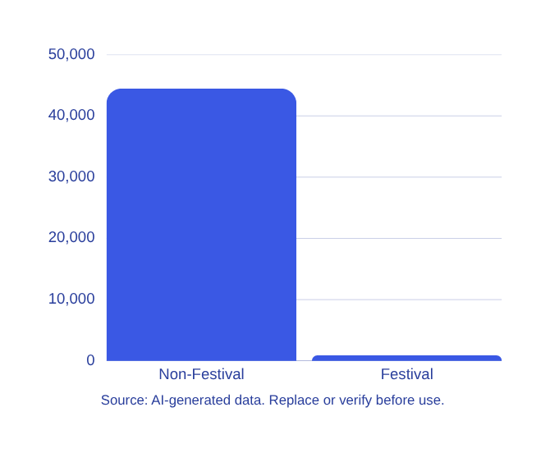
05
Festival
Order Analysis
IMPACT OF FESTIVALS ON CUSTOMER ORDERING BEHAVIOR
896
Analysis of order distribution reveals a stark contrast between festival and non-festival periods. Non-festival days account for 44,469 orders, representing the overwhelming majority of total business volume. Festival orders account for only 896 orders, highlighting a significant untapped opportunity. This gap suggests that customer ordering behavior is not strongly influenced by festive seasons — presenting a clear opportunity to introduce targeted marketing campaigns, promotional discounts, and special offers during festival periods to drive order volume and boost revenue during these high-engagement windows.
Festival orders vs 44,469 non-festival orders

Slide 6

Traffic Density Distribution
LOW TRAFFIC
15,477
01
Low traffic conditions account for the highest delivery volume at 15,477 orders. Deliveries are faster, more predictable, and operationally efficient, making low-traffic periods the most productive for fleet performance.
LOW TRAFFIC PEAK DELIVERIES
JAM & MEDIUM TRAFFIC
02
LOW TRAFFIC
Jam traffic contributes 14,143 deliveries while medium traffic accounts for 11,548. These conditions introduce delays and route unpredictability, highlighting the need for dynamic traffic-aware routing solutions.
15,477 deliveries recorded under low traffic — the highest among all traffic conditions.
HIGH TRAFFIC IMPACT
JAM & MEDIUM TRAFFIC
Jam traffic: 14,143 deliveries. Medium traffic: 11,548 deliveries.
03
High traffic conditions result in only 4,425 deliveries — the lowest count. Traffic density directly impacts delivery efficiency and route planning, signaling a critical area for operational improvement and optimization.
HIGH TRAFFIC
Only 4,425 deliveries under high traffic — the lowest volume, reflecting major efficiency constraints.

Slide 7
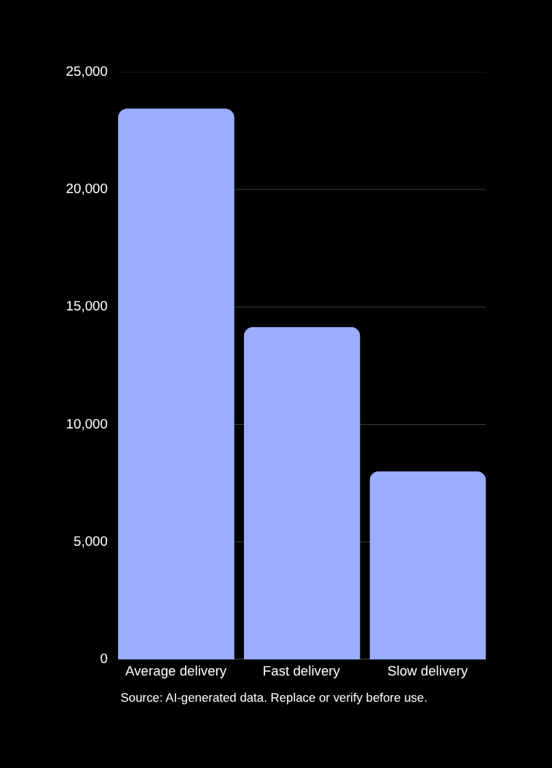
07
Delivery Category Analysis
CLASSIFICATION OF DELIVERIES BY DELIVERY SPEED AND PERFORMANCE
Deliveries are segmented into three categories based on speed. The majority — 23,438 orders — fall under the Average category, indicating most deliveries are completed within expected timeframes. Fast deliveries account for 14,149 orders, reflecting strong operational efficiency. Slow deliveries represent 8,006 orders, highlighting an area for targeted improvement through route optimization and resource allocation.
45.6K
TOTAL ORDERS ANALYZED

Slide 8
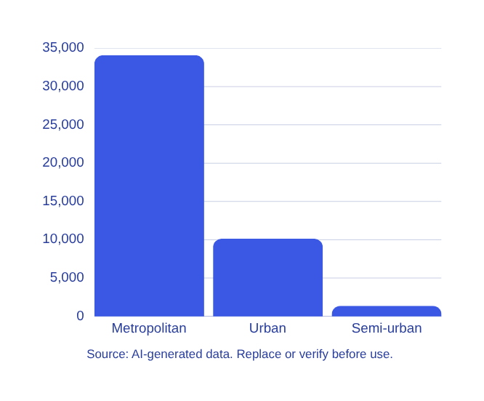
08
City-wise
Order
Distribution
OVERVIEW OF ORDER VOLUME BY CITY TYPE AND CATEGORY
Metropolitan cities account for the overwhelming majority of food delivery orders, with 34,093 orders — far exceeding Urban (10,136) and Semi-urban (1,364) areas. This distribution highlights that metropolitan regions are the primary customer base and the core driver of business volume. The stark contrast between city types underscores the need to prioritize resource allocation, delivery infrastructure, and marketing efforts in metropolitan zones. Expanding capacity and service quality in urban areas presents a significant growth opportunity, while semi-urban regions remain largely untapped markets with long-term potential for strategic expansion.
34K+
Orders from
Metropolitan
cities

Slide 9
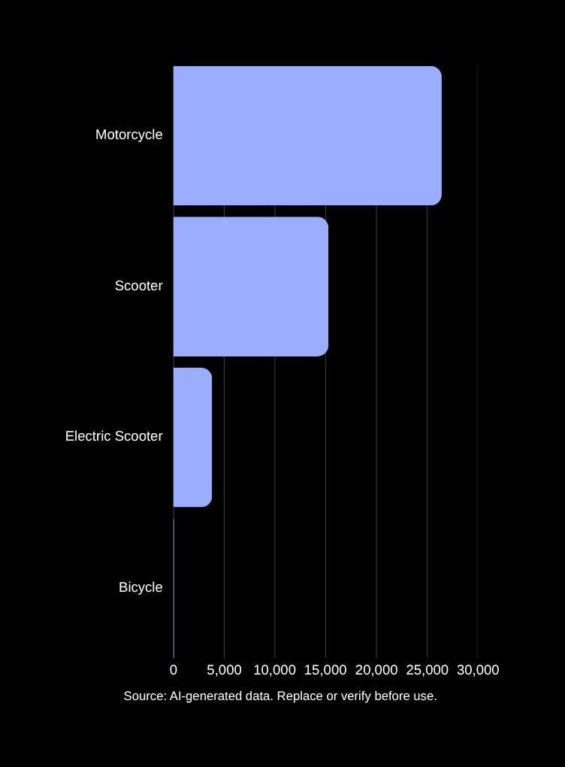
09
Vehicle-wise Order Distribution
DELIVERY VOLUME BREAKDOWN BY VEHICLE TYPE ACROSS ALL ORDERS
Motorcycles lead all vehicle types with 26,435 deliveries, making them the most efficient and preferred mode for food delivery. Scooters follow with 15,276 deliveries, while Electric Scooters account for 3,814 orders, reflecting a growing shift toward sustainable transport. Bicycles contribute minimally with only 68 deliveries. Motorcycles dominate due to their speed, maneuverability, and fuel efficiency across urban and metropolitan routes. Investing in motorcycle fleet expansion and transitioning toward electric scooters can improve both delivery performance and environmental sustainability.
26K
MOTORCYCLE DELIVERIES RECORDED

Slide 10

10
Overall Business Insights
SUMMARY OF KEY FINDINGS FROM THE ANALYSIS
Total orders analyzed: 45,593 | Avg customer rating: 4.634/5 | Avg delivery time: 26.29 minutes.
Metropolitan cities generate the highest order volume (34,093); motorcycles are the most used delivery vehicle (26,435).
Low traffic conditions yield the highest delivery volumes; most deliveries occur during non-festival periods.
Majority of deliveries fall under the Average category (23,438), reflecting consistent and reliable delivery performance.

Slide 11




01
02
03
04
FESTIVAL SEASON PROMOTIONS
EXPAND METROPOLITAN CAPACITY
TRAFFIC-AWARE ROUTE OPTIMIZATION
BOOST EV USAGE & REDUCE SLOW DELIVERIES
Introduce targeted marketing campaigns during festival periods to capitalize on untapped demand and increase order volume beyond the current 896 festival orders.
Scale delivery resources and infrastructure in metropolitan cities, which account for 34,093 orders — the highest volume — to sustain growth and meet rising demand.
Implement dynamic, traffic-aware routing to reduce delivery delays during high and jam traffic conditions, improving overall delivery efficiency and customer satisfaction.
Expand electric scooter fleet adoption for sustainability gains, and address slow-category deliveries (8,006 orders) through operational improvements to shift more orders into the fast category.
Business Recommendations
These strategic recommendations are derived from dashboard insights to enhance delivery performance, improve customer satisfaction, optimize operations, and drive sustainable business growth across all city types.

Slide 12

12
Conclusion
FOOD DELIVERY SYSTEM ANALYSIS – PROJECT SUMMARY
The Food Delivery System Analysis dashboard provides a comprehensive view of delivery performance using Tableau, enabling real-time monitoring of operational efficiency and customer satisfaction.
Key insights across traffic conditions, city types, vehicle usage, and festival impact empower decision-makers to identify trends and improve delivery operations.
Through interactive data visualization, this project reinforces a data-driven approach to enhancing food delivery system performance and supports strategic business planning for sustainable growth.

Slide 13

Thank You!
Food Delivery
System
Analysis
Rucha
Presenter
Food Delivery System Analysis – Capstone Project 1. Presented by Rucha using Tableau. Dataset: Food Delivery System Dataset. Thank you for your attention and valuable time.
Capstone Project – 1
Tool Used: Tableau
Dataset: Food Delivery System Dataset

